Slide 1
Credit EDA Case Study
By
Tairu Adewale
Intern NO: OGTIPTADA377
Guided by ARITRI DEBNATH

Slide 2
TOPICS
INTRODUCTION AND PROBLEM STATEMENT
LIBRARIES USED AND DATA CLEANING
EXPOLATORY DATA ANALYSIS
Univariate Analysis
Bivariate Analysis
Multivariate Analysis
CONCLUSION

Slide 3
INTRODUCTION AND PROBLEM STATEMENT
Introduction
Effective risk management is critical to lending institutions' stability and performance in the ever-changing financial services industry. Understanding and forecasting loan default is essential to risk management since it has a direct impact on a company's financial stability. An effective tool in this effort is exploratory data analysis (EDA), which offers insights into the trends and factors that serve as warning signs for borrowers who are having trouble repaying their debts.
Problem Statement:
The primary challenge addressed in this project is to identify patterns and key variables that serve as strong indicators of loan default.

Slide 4
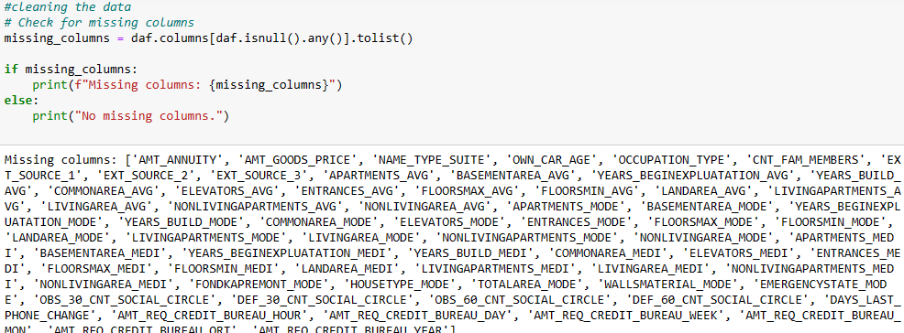
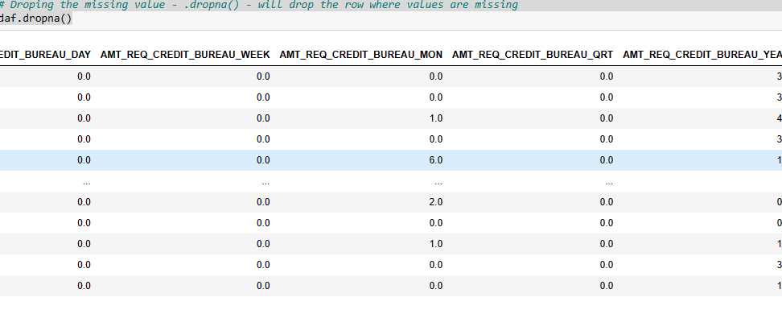
IMPORTING LIBRARIES AND HANDLING DATA CLEANING FOR BETTER VISUALIZATION
Libraries such as pandas, matplotlib,pyplot, and seaborn were used.
Data cleaning was done for better visualization

Slide 5
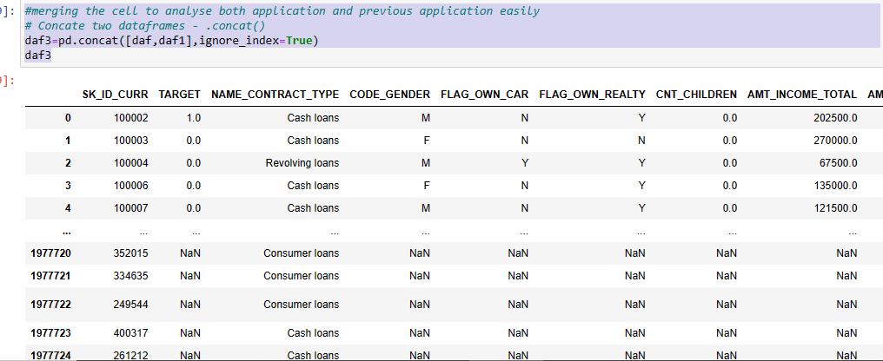
EXPOLATORY DATA ANALYSIS
Merging the CSV files for better understanding and analysis

Slide 6
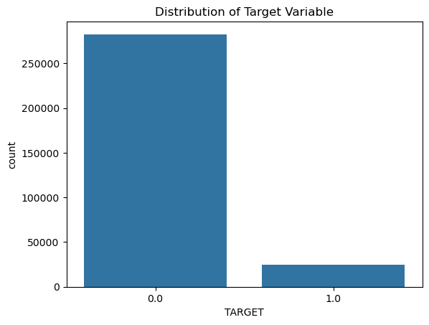
EDA CONTD
Distribution of the target variable suggests that instances of payment difficulties are relatively less common in the dataset.

Slide 7
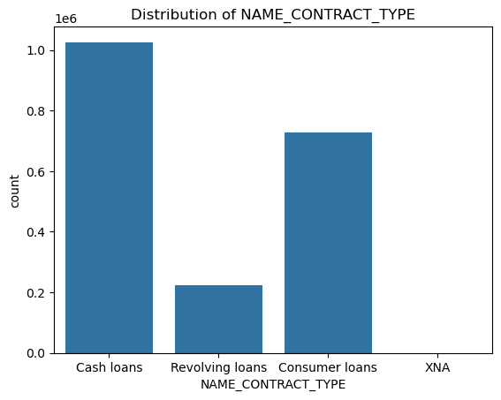
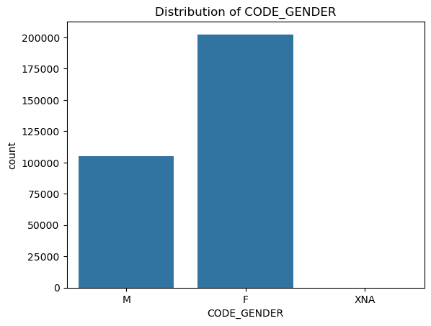
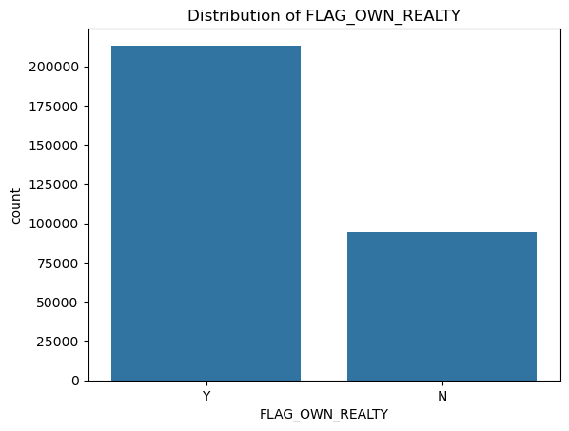
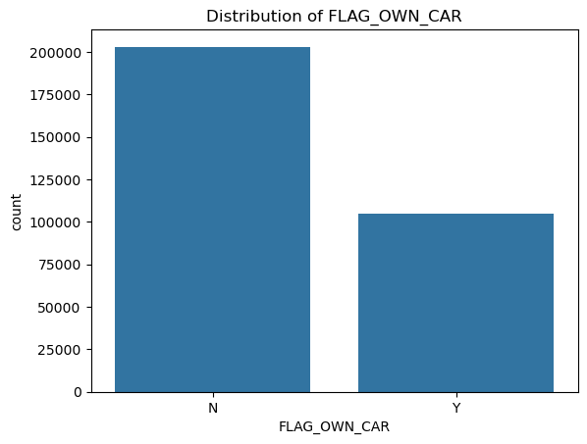
UNIVARIATE ANALYSIS
This analysis shows the distribution of contract type, Gender, Car Ownership and Real estate Ownership

Slide 8
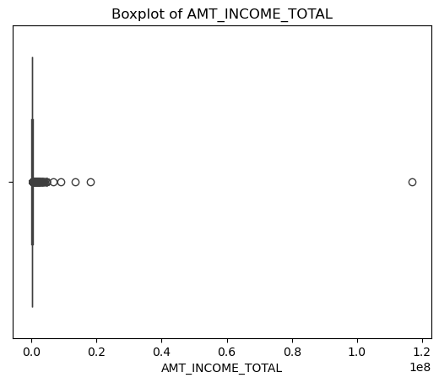
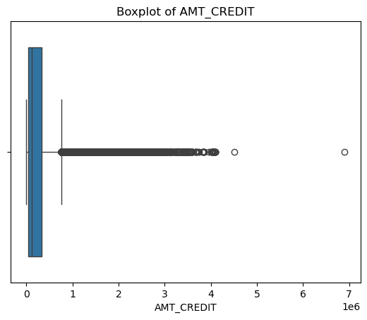
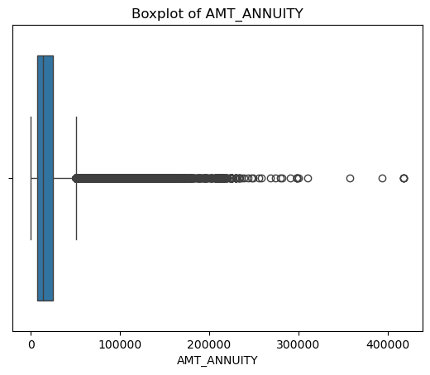
BIVARIATE ANALYSIS
Boxplot of Amt_Income_Total shows a high outlier which affects the distribution of the variable. It suggests that people obtaining loan are financially capable to make repayments.
Boxplot of Amt_income_Annuity shows a normal distribution of variables suggesting that people obtaining loans are making their repayments to the lenders periodically over the specified time.

Slide 9
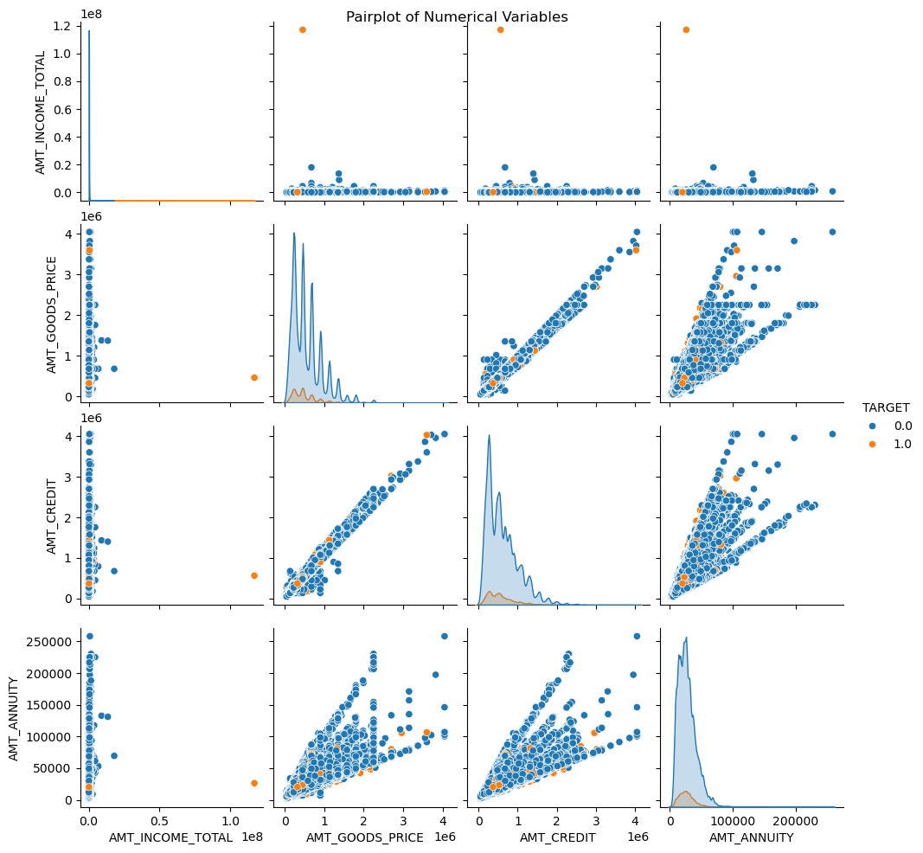
MULTIVARIATE ANALYSIS
The pair plot shows that there are positive correlation between the variables, strongest between Amt_credit and Amt_goods_price which implies that the linear relationship might be a result of the credit influencing purchasing power of products.

Slide 10
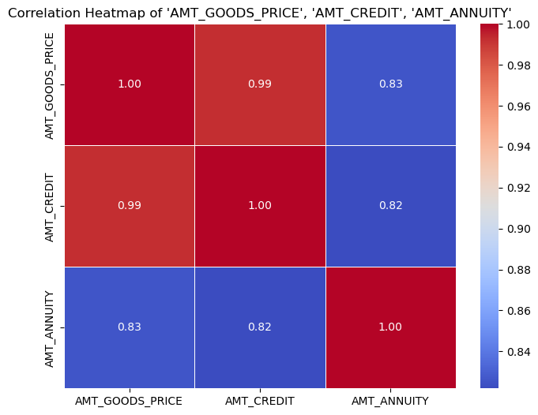
MULTIVARIATE ANALYSIS CONTD
Most variables are observed to have a linear relationship with each other.

Slide 11
CONCLUSION
The EDA yielded a thorough comprehension of the dataset by recognizing trends, distributions, and correlations among variables.

